Slide 1




Datathon 2025
Notes:
1

Slide 2

Team Information
Team Name: Vashishtha
Problem Statement: Long queues in the canteen lead to delays during lunch breaks. Design a system that counts people in the queue, displays waiting times, and sends alerts to students when their turn is near.
College Name: MIT Academy of Engineering, Pune
Problem Statement Id: PROB1122
Section: Hardware
Year: TY
Notes:
3

Slide 3


Meet the Team
Vaibhav Pawankar
Role: Hardware Integration
Email: vaibhav.pawankar@mitaoe.ac.in
Alvin Abraham
Role: Cloud and Database Management
Email: alvin.abraham@mitaoe.ac.in
Kaustubh Mahajan
Role:
Email: kaustubbh.mahajan@mitaoe.ac.in
Sanskruti Shetiya
Role:
Email: sanskruti.shetiya@mitaoe.ac.in
Notes:
2

Slide 4

The Challenge: Problem Statement
Detailed Problem: At MIT Academy of Engineering, students often face long queues in canteens, admin offices, and event registrations, leading to delays. To solve this, the Girl Script MIT AOE club proposes an IoT-based Smart Queue System using IoT sensors and digital displays. The system will detect the number of people in a queue, show the estimated waiting time on a screen, and send alerts when a student’s turn is near.
Key Challenges:
Accurate People Detection & Counting
Real-Time Data Processing & Connectivity
User Adoption & System Integration
Notes:
3

Slide 5




Tech Stack: Software & Hardware
Software
Embedded C , Python, C++, YOLO, Google FireBase
Hardware
Tensor Based Object Detection, NFC Tags, Cameras, NFC reader
Environment
STM32 CubeIDE, Python with PN532 Library, WhatsApp Business API
Our solution uses cutting-edge software and hardware. Cloud-based IDE for seamless collaboration.
Notes:
4

Slide 6





Inspiration Behind Our Solution
Existing Solutions
OpenPose- Limitation: 1. High Computational Load
2. Latency
Source 1
Key takeaway: Human pose estimation and tracking Technique
Source 2
Key takeaway: Multi-person tracking in dynamic scenarios
Notes:
5

Slide 7

Innovation & Creativity
Novelty
Technical Details
Reduction in queue waiting time
30-50% Reduction in waiting time VS Traditional manual queue systems
AI Queue Detection:
Uses YOLOv8 & OpenCV for real-time people counting
Eliminates false queue detections
NFC-based User Recognition:
MIFARE NFC tags with student details linked to a database
Automatic WhatsApp notifications via Twilio API
Unique Features:
AI-powered queue detection with false entry filtration
Scalability
Market Potential in India:
Estimated Market Size: ₹500 Cr+ (expanding to colleges, hospitals, & public offices)
Can be integrated with UPI payments for automated check-in & payments
Notes:
6

Slide 8
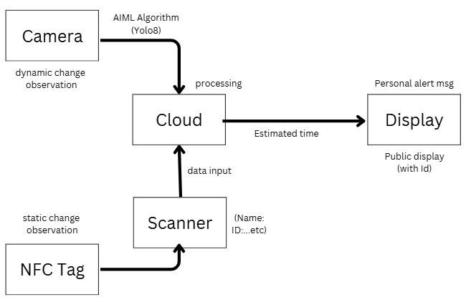
System Architecture
Key Components:
Camera (AI-Powered People Detection)
Uses YOLOv8
NFC Tag (User Identification)
Each student has an NFC tag linked to their ID,
name, and contact details.
Scanner (NFC Reader)
Reads NFC tags and extracts user information
Cloud (Data Processing & Estimation)
Processes input from the camera (queue detection)
and NFC scanner
Notes:
7

Slide 9
Complete Description
Working of IoT-Based Smart Queue System
AI Queue Detection → Camera detects & counts people using YOLOv8.
False Detection Filtering → Ignores people just passing by.
NFC Tag Scanning → Users tap NFC tags to register in the queue.
Cloud Processing → Cloud calculates estimated wait time.
Queue Mapping → Links NFC user data with queue position.
Public Display Update → Shows real-time queue length & wait time.
WhatsApp Notifications → Sends estimated wait time to users.
Automated, fast, and efficient queue management system!
Notes:
7

Slide 10

Conclusion
✅ Reduces waiting time with AI-powered detection.
✅ Accurate queue tracking with false detection filtering.
✅ NFC-based user registration for automation.
✅ Real-time updates via displays & WhatsApp alerts.
✅ Cloud-based processing for efficiency.
✅ Scalable & future-ready for various public spaces.
Notes:
9

